Slide 1
CSE 3200 : System Development PROJECT
House Rent

Slide 2
House rent
Supervised By:
H.M. Abdul Fattah
Lecturer
Dept. of Computer Science and Engineering,
Khulna University of Engineering & Technology
Khulna.
Presented By :
Nohel Nath
Roll : 1607013
Mahmudur Rahman limon
Roll : 1607049
Dept. of Computer Science and Engineering,
Khulna University of Engineering & Technology
Khulna

Slide 3
Key Points
Statement of problem
Platform Choosing
Database choosing
Technical details
Activity diagram and features
Limitations
Future plan
Learning outcomes
Conclusion
References

Slide 4
Statement of Problem
Maintaining all the information related to owner and renter
Building a system for renter to find houses in different location
Renter don’t need any helping assistant and they don’t need to do any hard labor to find houses
Renter can show the house details so that they can choose the perfect house
Maintaining the overall process in a online house renting system.

Slide 5
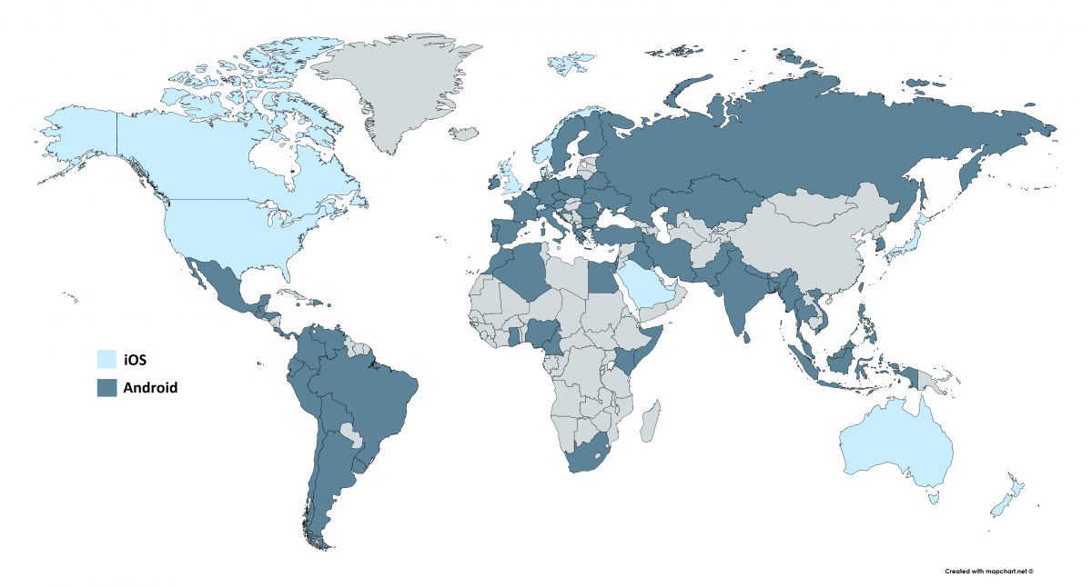
Platform Choosing
Why Android platform ?
Wider Pool of Customers.
According to latest reports, there are 106,000,000 active mobile phone
Among them 5 lac use android operated smartphones.
Easier Installation.
Easier Entry to Market.
Custom ROMs.
Compatible with More Devices.
Easier to learn for developers.
Resource:
1.https://www.quora.com/How-many-smartphone-users-are-in-Bangladesh

Slide 6
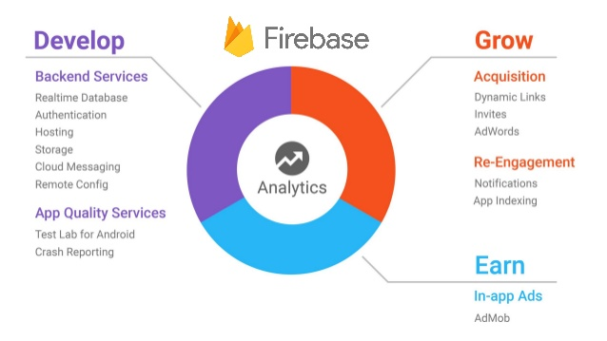
Database choosing
Source : https://www.quora.com/growth-of-firebase/

Slide 7
Technical details
Owner and Renter Signup
Add House
House Details
Renting House
Showing profile

Slide 8
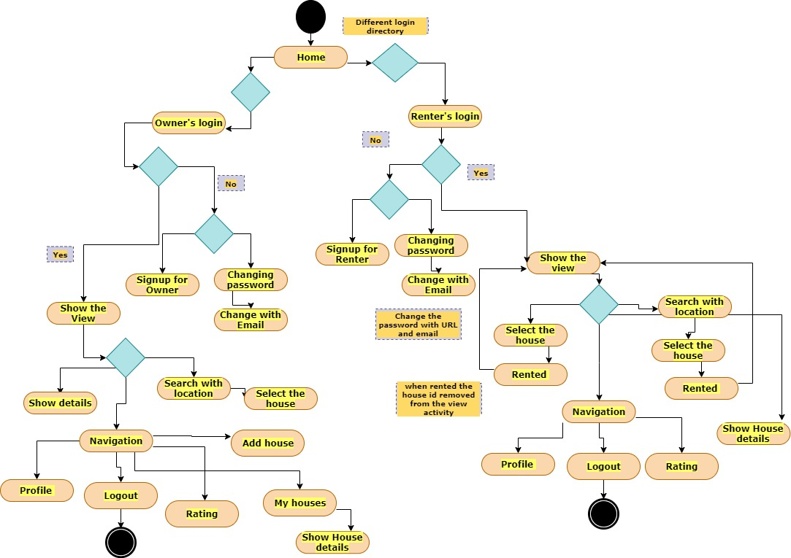
Activity Diagram and features
HOUSE RENT ACTIVITY DIAGRAM

Slide 9
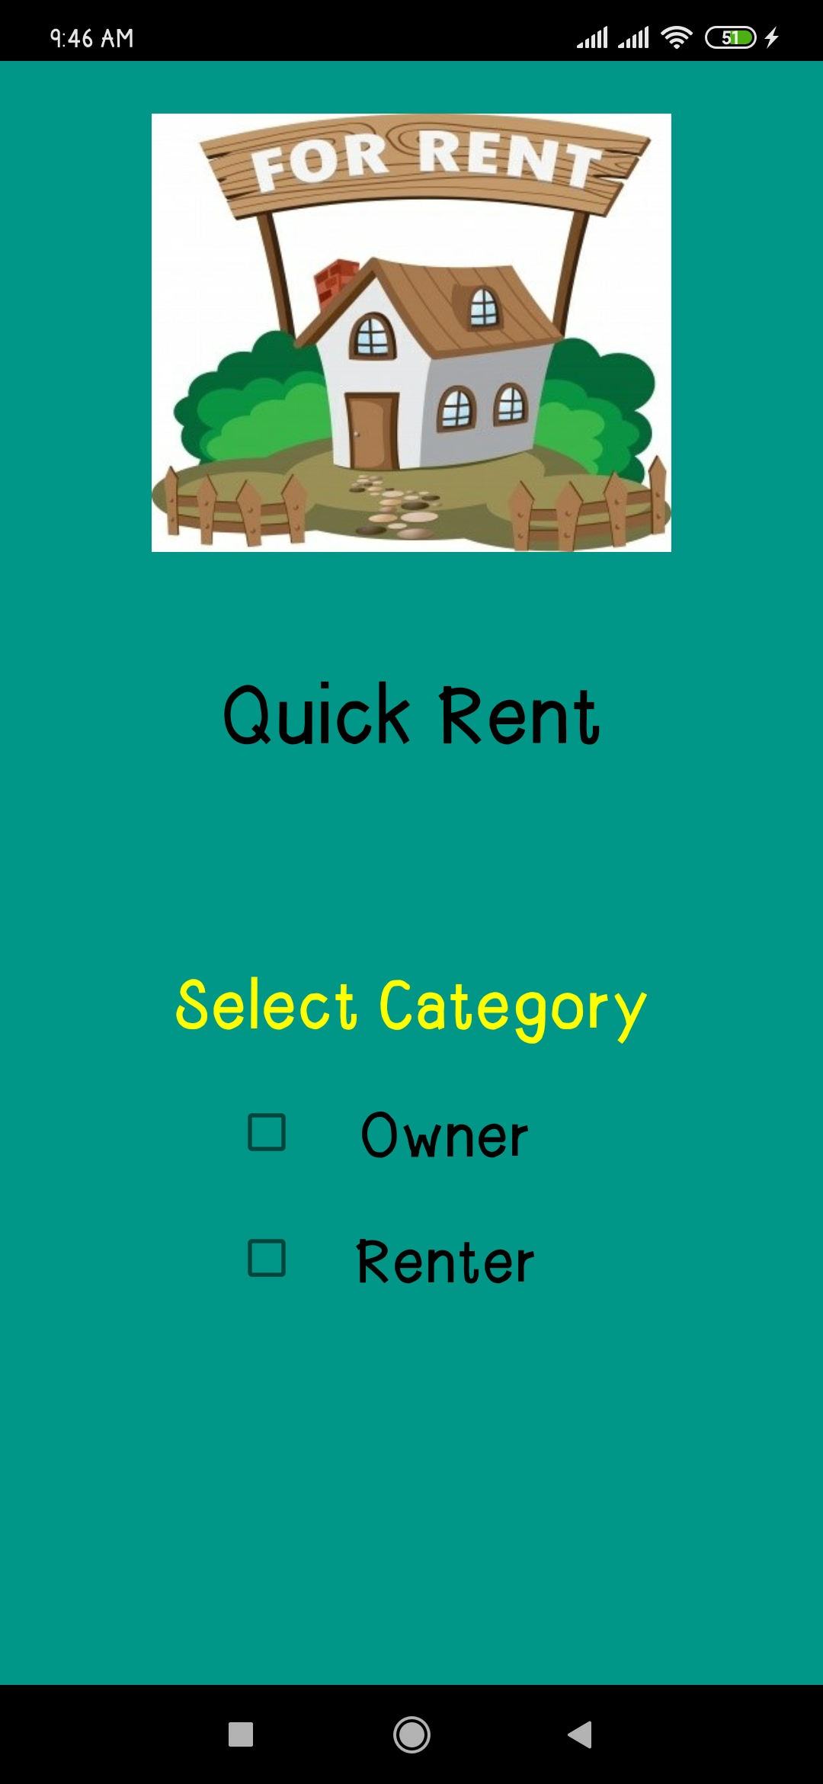
Activity Diagram and features
FRONT PAGE
User needs to open the app
User needs to select one category as owner or renter
Figure 1: Front Page

Slide 10
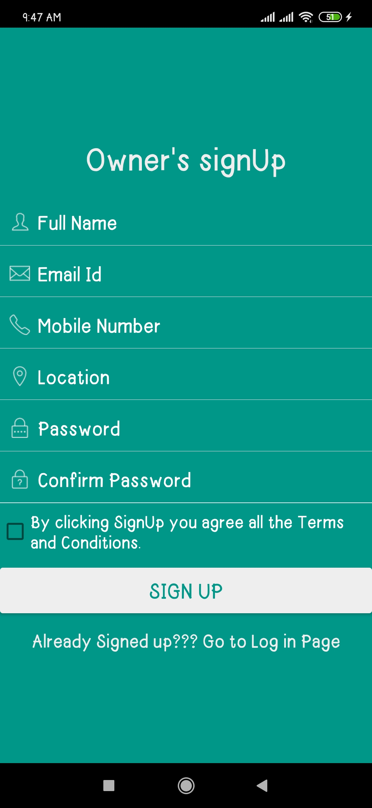
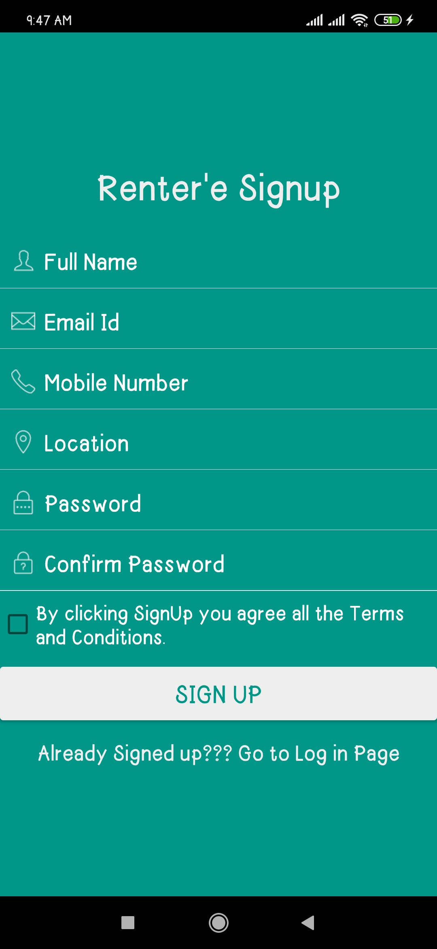
Activity Diagram and features
Signup page
Six steps should be maintained. This data will be added in firebase.
Figure 2: SignUp Page

Slide 11
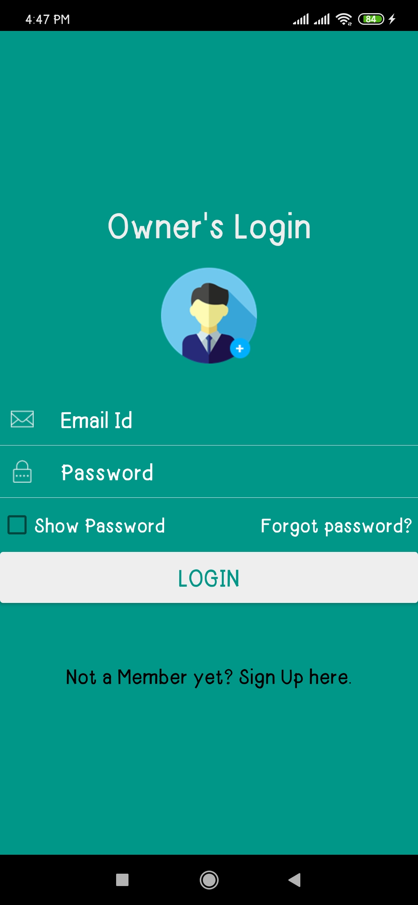
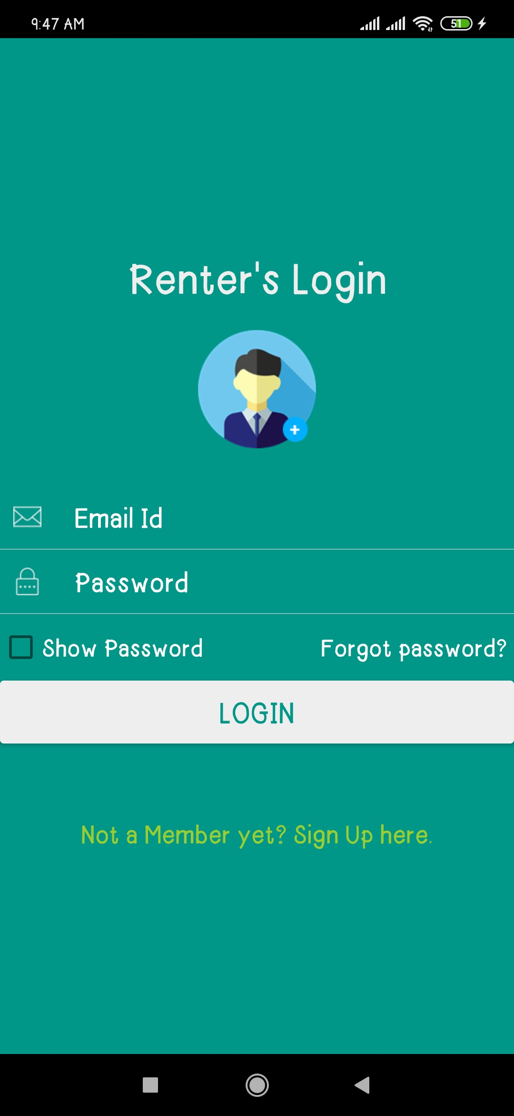
Activity Diagram and features
Login page
If registration complete successfully user can login successfully.
Figure 3: Login Page

Slide 12
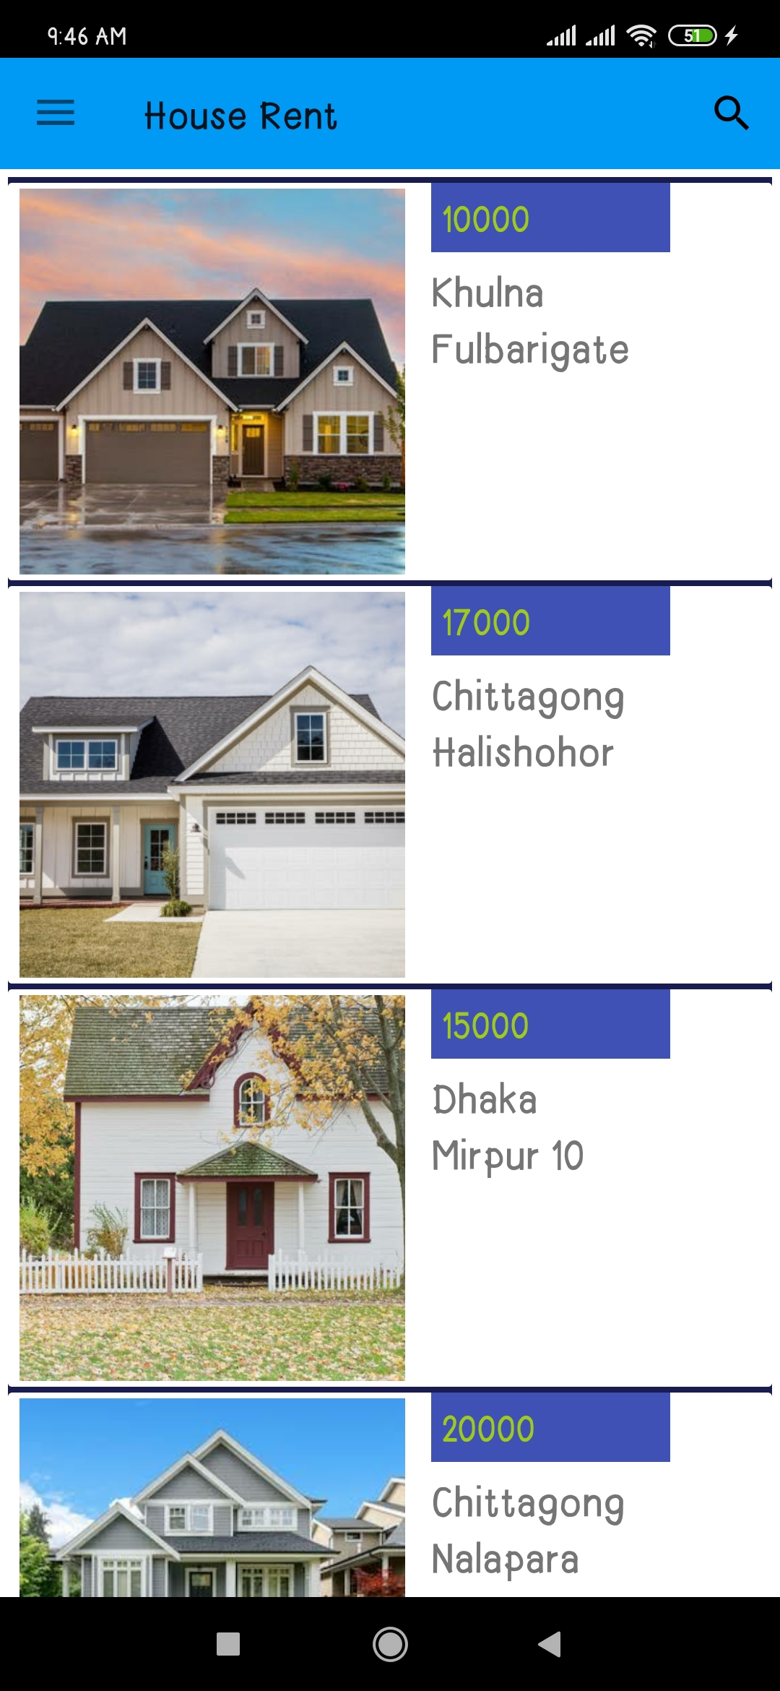
Activity Diagram and features
owner & Renter Page
After login successfully owner can show all adding house .
Figure 4 :Owner and Renter Page

Slide 13
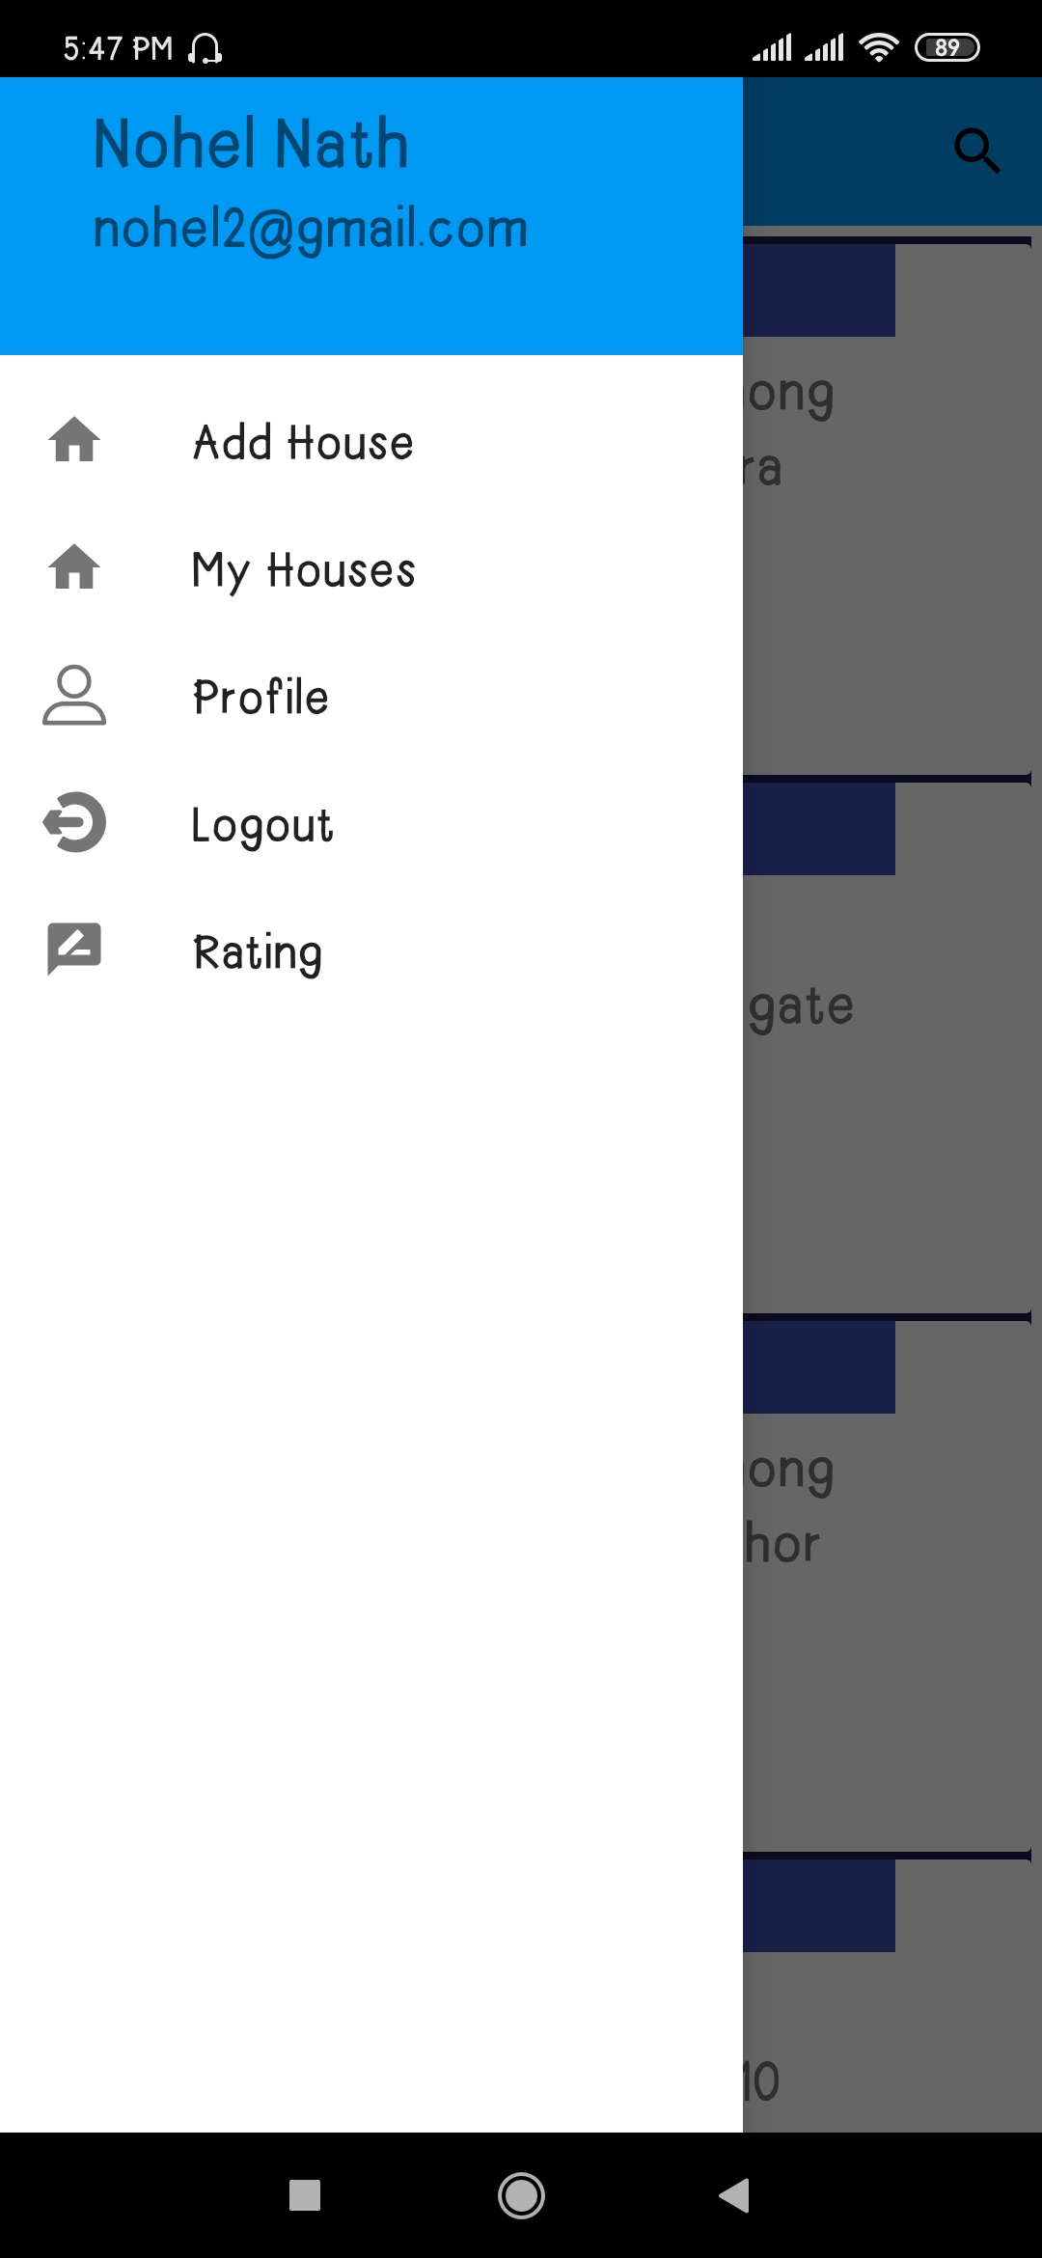
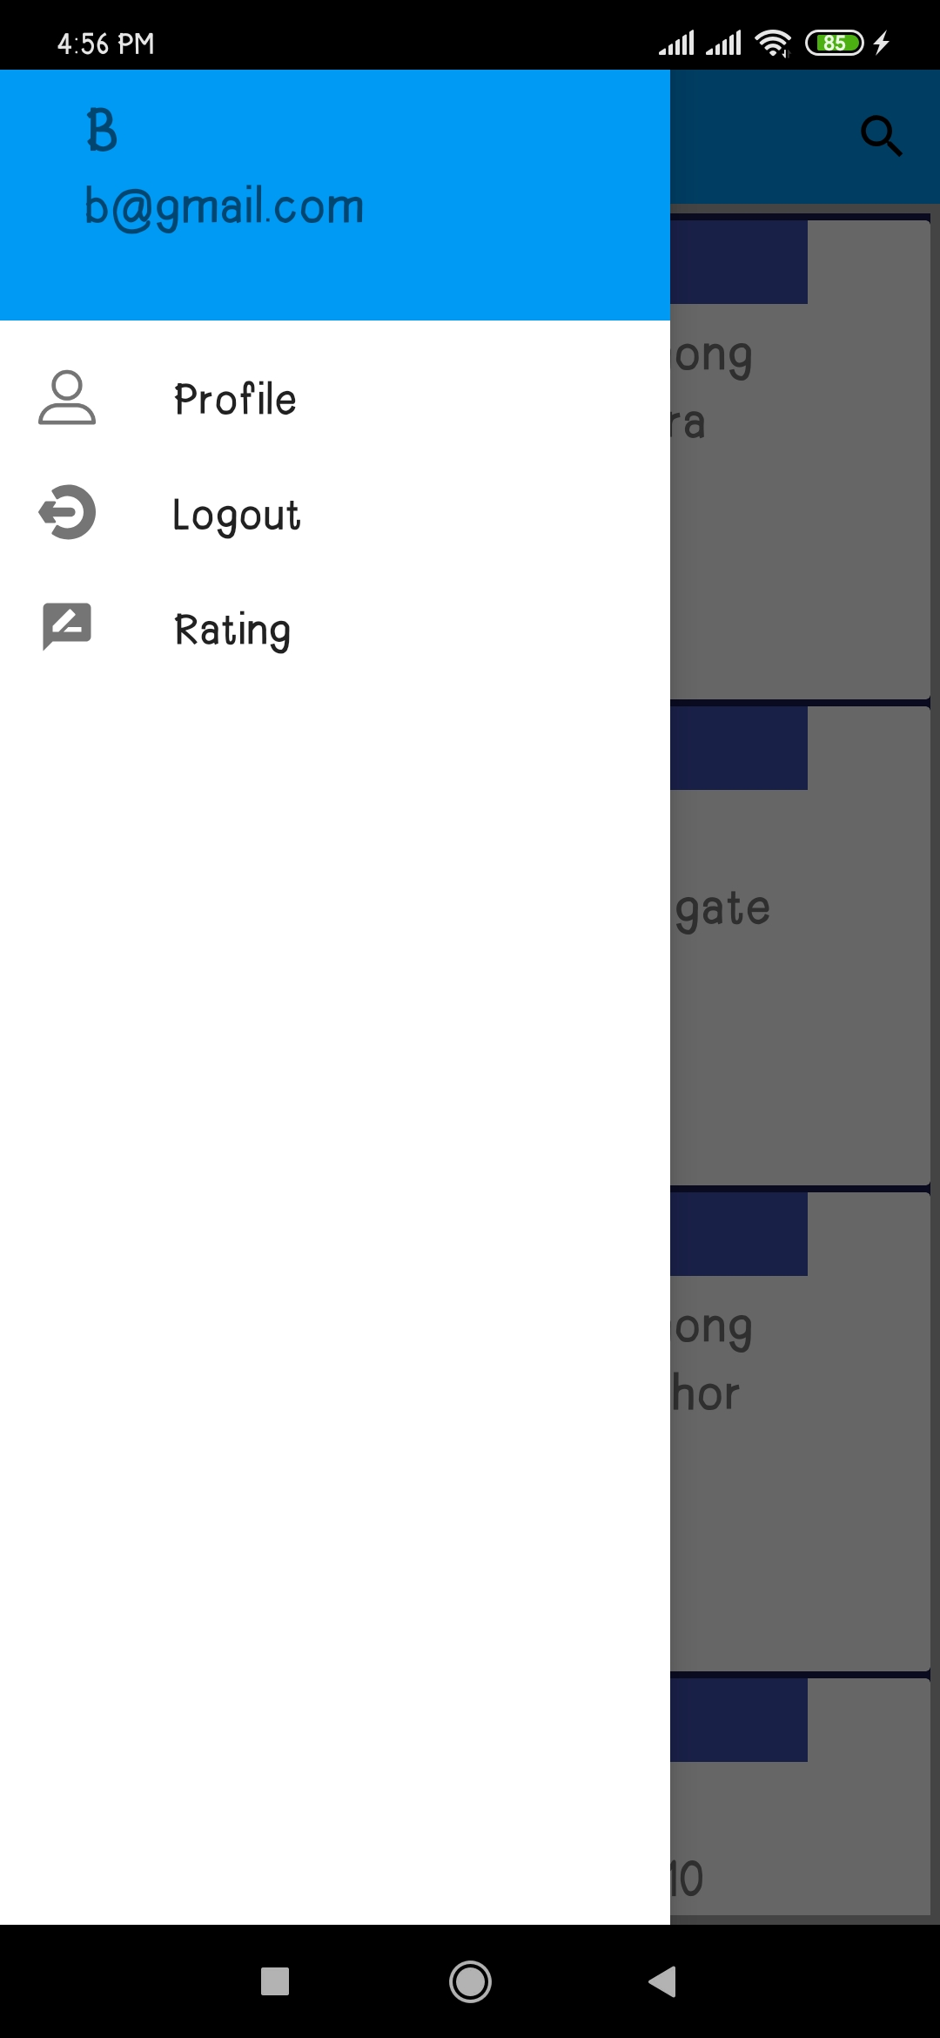
Activity Diagram and features
Navigation view
Navigation drawer are almost same but in the owner drawer extra two options Add House and My Houses are got.
Figure 5 : Navigation View for Owner and Renter

Slide 14
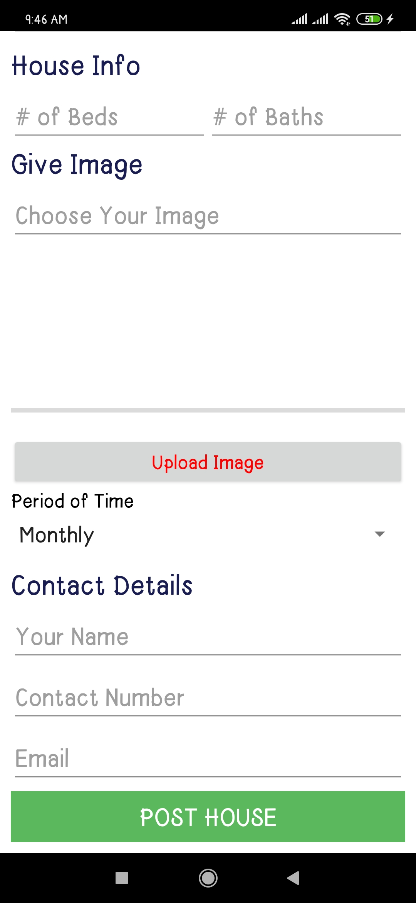
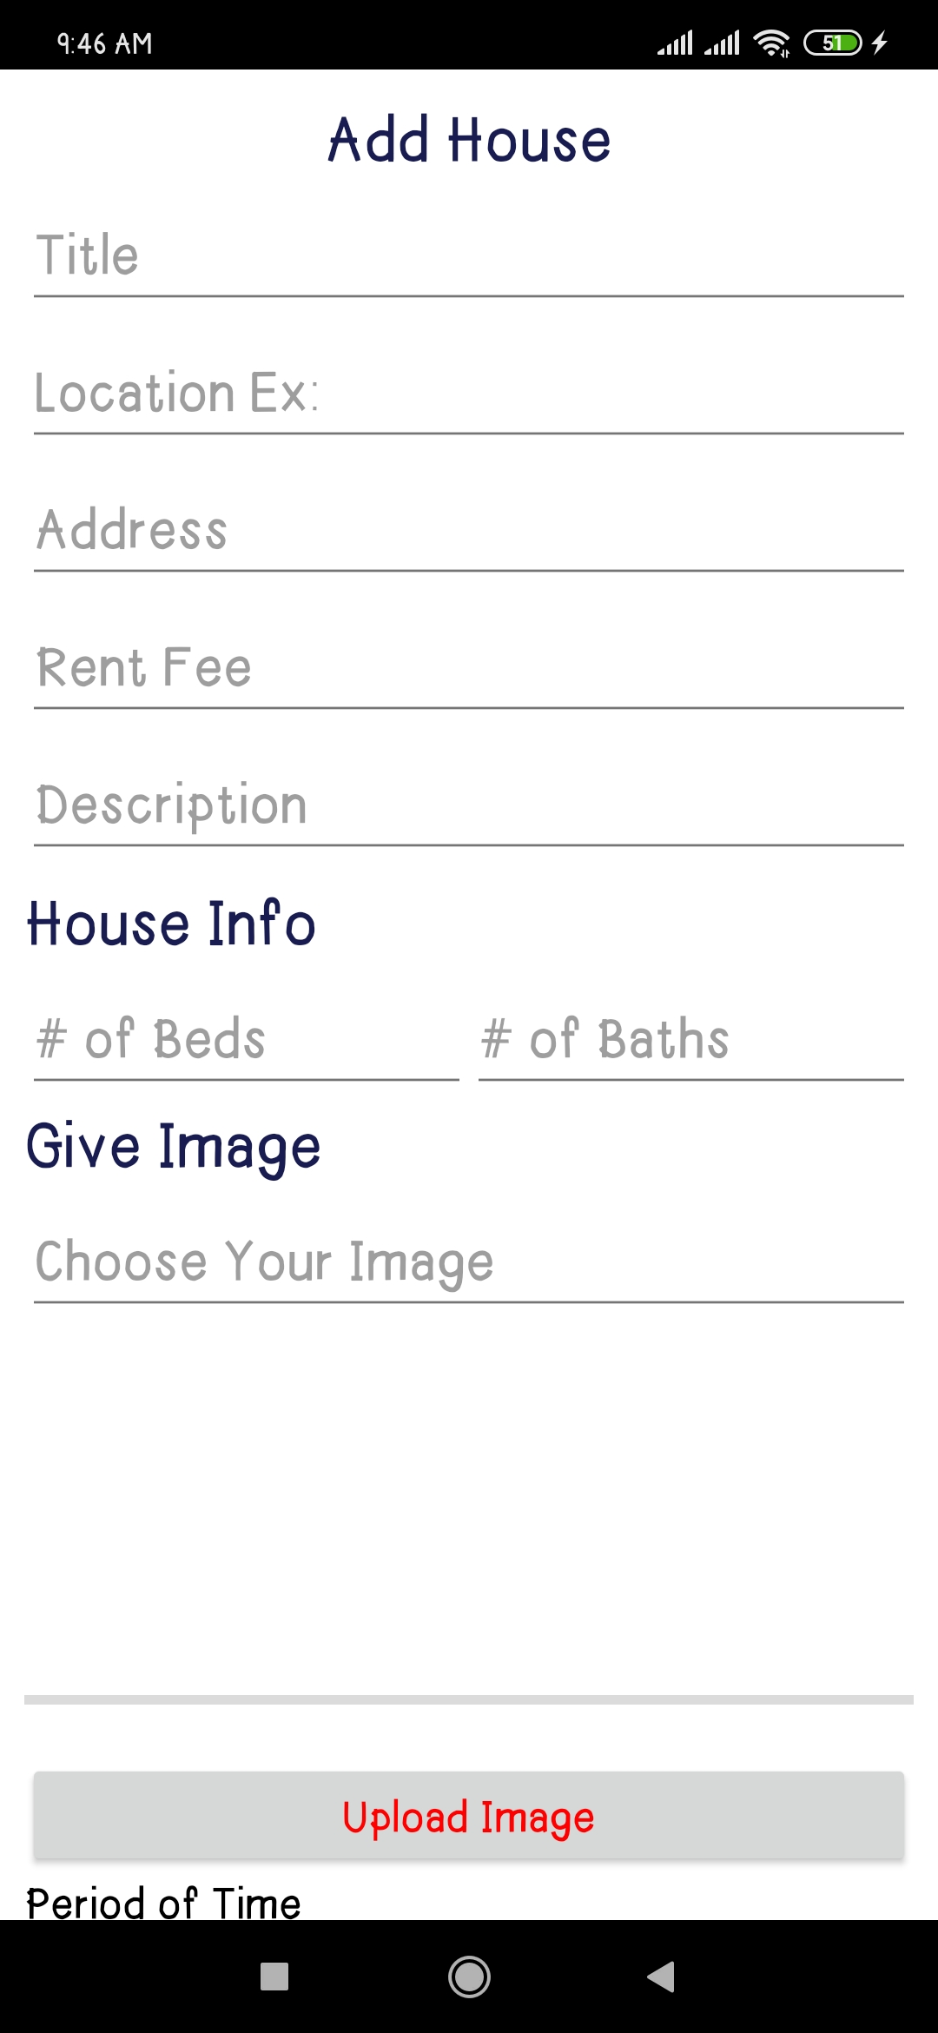
Activity Diagram and features
Add house
Here owner can add a new house and the added house goes to the view page.
Figure 6: Adding House

Slide 15
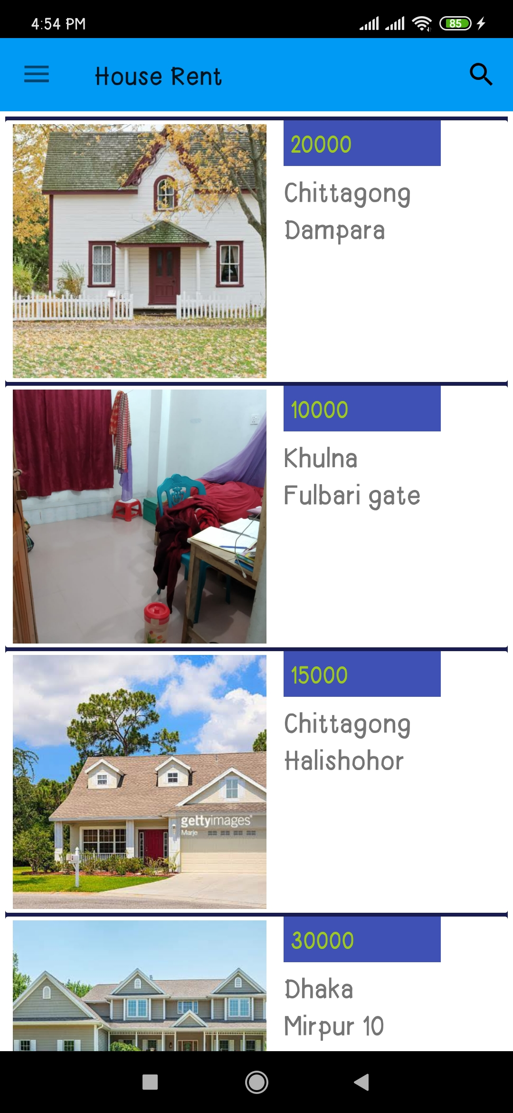
Activity Diagram and features
My HouSes
Owner can show all houses what he added before.
Figure 7: Random Owner’s House

Slide 16
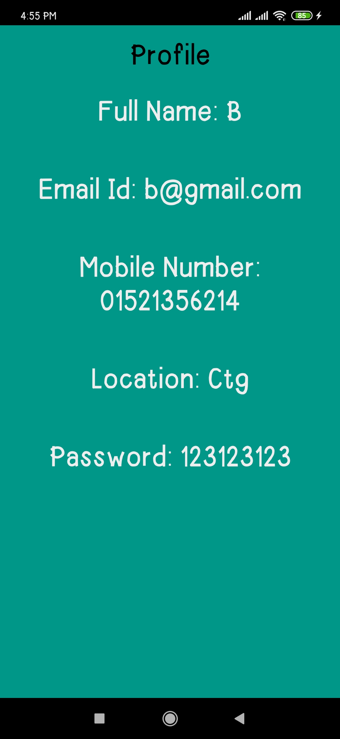
Activity Diagram and features
Profile
Owner and renter can see their profile .
Figure 8: User Details

Slide 17
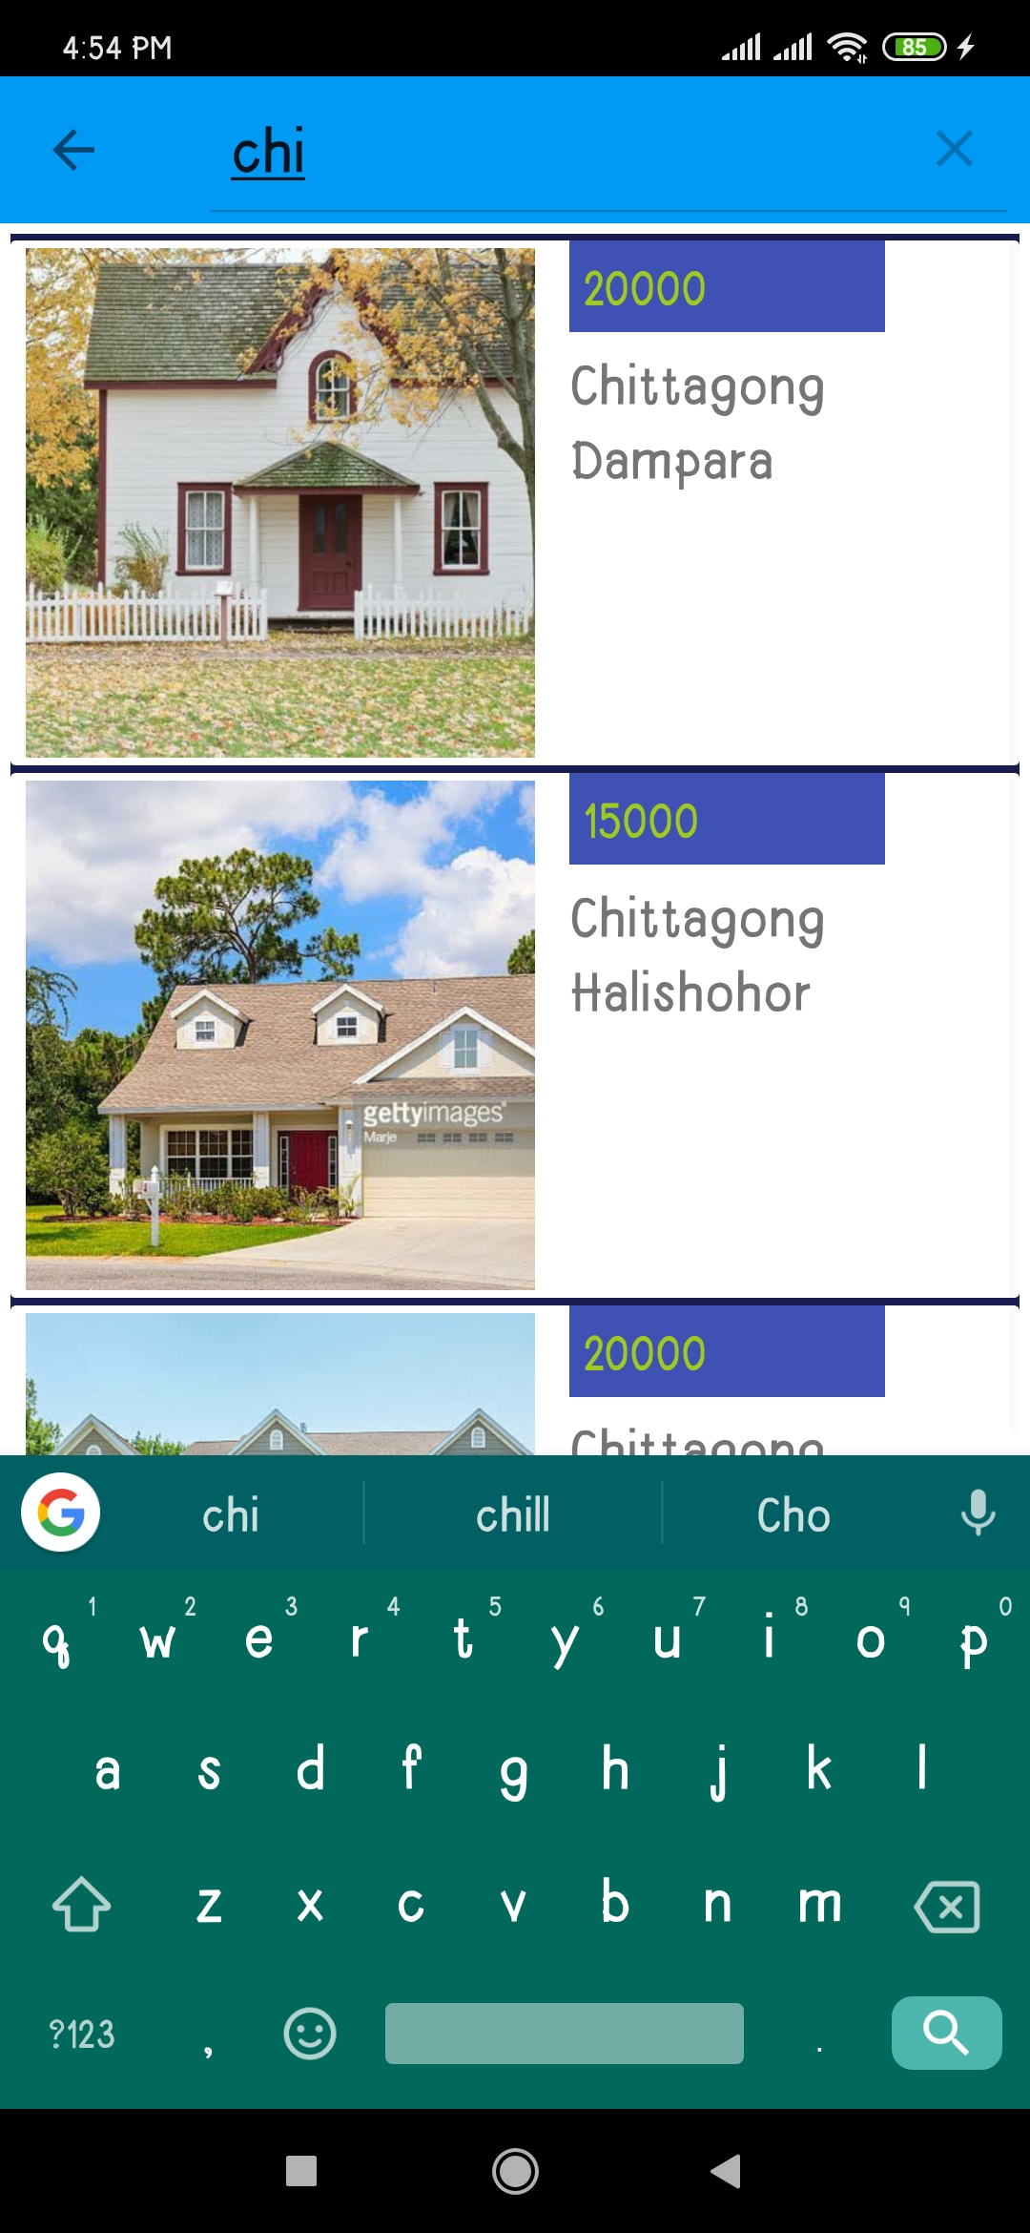
Activity Diagram and features
Search Option
Owner and renter both can search houses by location.
Figure 9 : Search Option

Slide 18
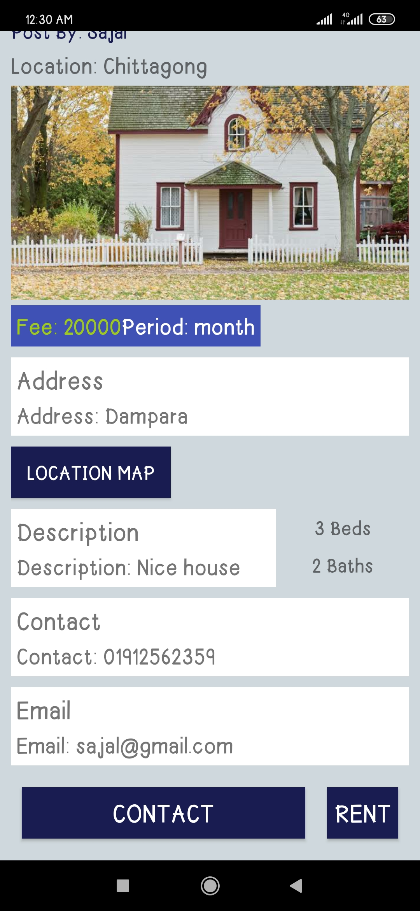
Activity Diagram and features
House Details
Owner and renter can show a random house details.
Figure 10: House Details

Slide 19
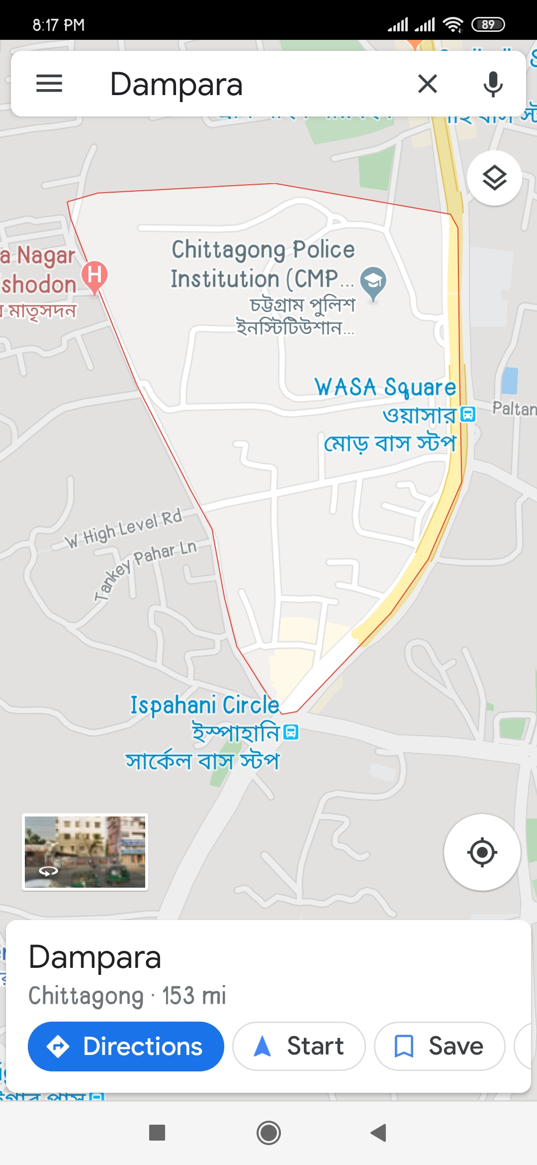
Activity Diagram and features
Google Map
Location will be seen in google map by clicking on the location button.
Figure 11: House Details

Slide 20
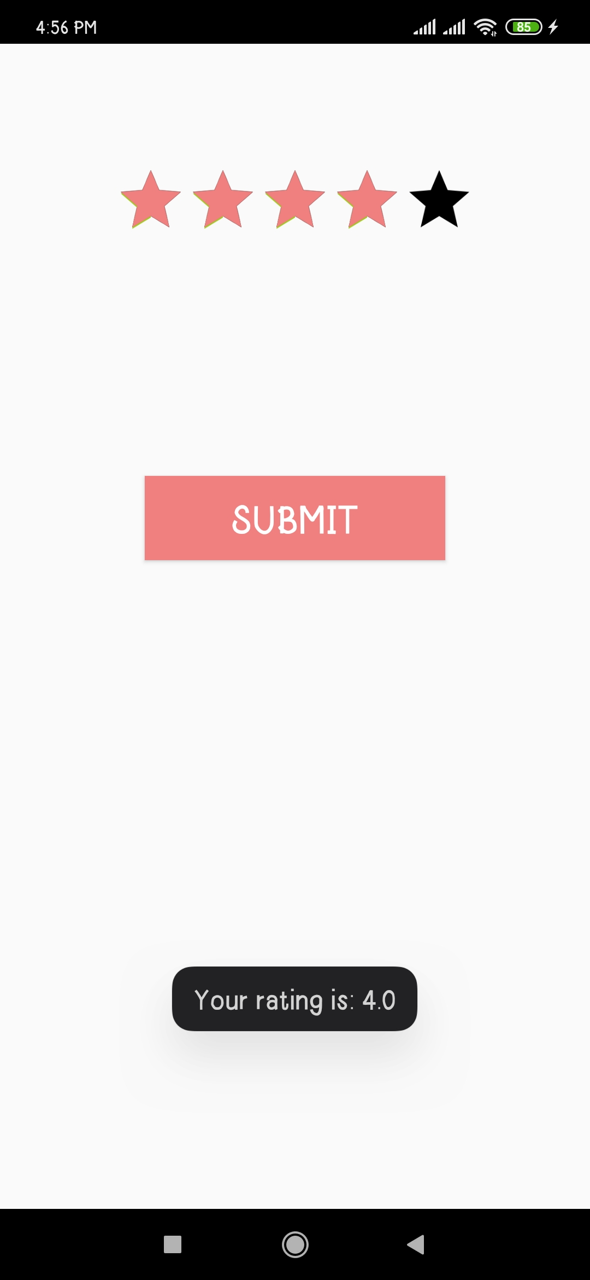
Activity Diagram and features
Rating
Owner and renter can rate this app.
Figure 12: House Details

Slide 21
Limitations
Suitable for a small online renting house system
Can’t show the exact locations sometimes because all over the locations are not included in the app
This app doesn’t properly maintained through the country.

Slide 22
Future Plan
Using all the locations properly to the house based location
Enhance user interface by adding more user interactive features
Payment options
Chat options between owner and renter
Try to make the apps auto update location based so in the certain location renter can see the latest houses near him
Offer details facilities of the houses to the home page
Allow to process a renter as a guest.

Slide 23
Learning outcomes
We are introduced to development of a overall system which is familiar in our daily life.
In the process of developing the system, we faced different types of problem and we tried to solve it.
In the process of solving problem, we learnt so many things
In this project we learnt how the development of a system works that will help us in future.

Slide 24
Conclusion
The system is designed to reduce human labor and efficiently maintaining the total renting process.
It provides a flexible way of renting houses
We hope that it will help people to reduce both time and trouble.

Slide 25
References
https://developer.android.com
https://firebase.org/
https://www.youtube.com/watch?v=vpObpZ5MYSE
https://www.youtube.com/watch?v=h62bcMwahTU

Slide 26
Thank you

